Slide 1
Introduction
Why Standards are Important?
Encapsulation of best practices; avoids repetition of past mistakes
Framework for quality assurance process; it involves checking standard compliance
Provide continuity; new staff can understand the organisation by the standards applied
SPICE : Software Process Improvement & Capability dEtermination
Also known as ISO/IEC 15504 is an International standard for SW Process Assessments
Mainly used in Europe & Australia by the Automotive Industry
Popularly termed as Automotive SPICE
Automotive SPICE Launched in April 2006
Its usage will increase mainly driven by HIS (Audi, BMW, Daimler Chrysler, Porsche, Volkswagen), FORD, VOLVO & FIAT
Each OEM has different target level; if these are not met, then;
Suppliers are requested to improve the development process
In case of High risks/low capability levels, the suppliers are excluded from sourcing

Slide 2
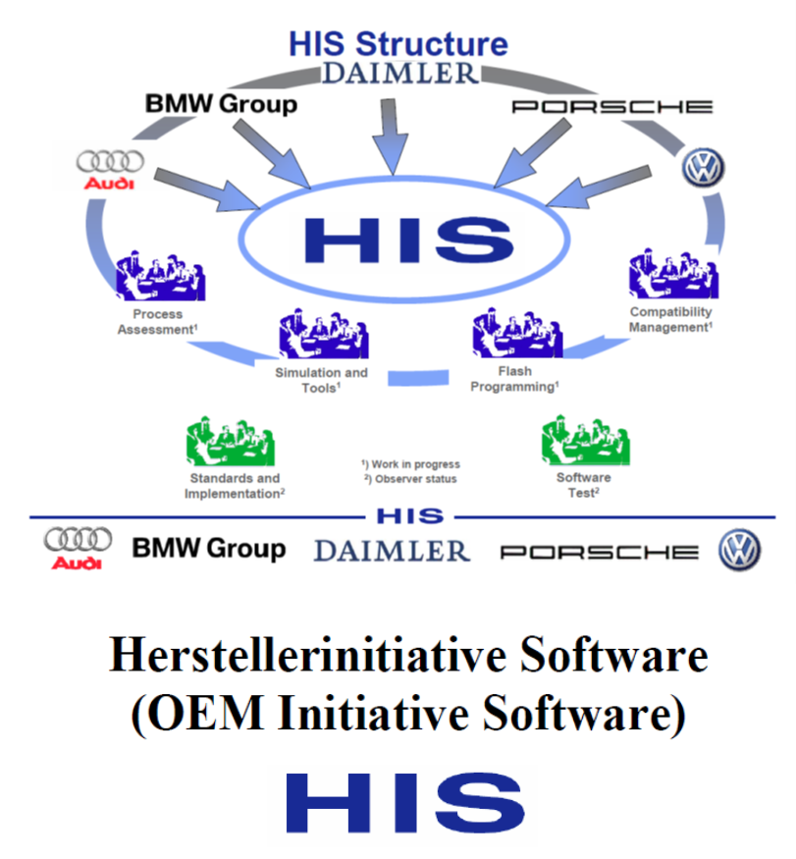
Automotive SPICE History
Objective:
Selection of a standardized assessment method - Solution: Automotive SPICE™
Transfer of experiences and results of the HIS and its members to extended working groups (Automotive SPICE™) for further developments
Outcomes:
In 2001 the automotive industry, major European car manufacturers (including HIS-members) have started the „Automotive SPICE™“ initiative together with the Procurement Forum and the SPICE User Group called AUTOSIG to develop an automotive specific SPICE variant
From 2001 to 2006 HIS members have executed about 200 SPICE assessments
All HIS members will perform and accept from 2007 on only Automotive SPICE™ assessments executed by iNTACS certified Automotive SPICE™ assessors.
HIS WG „Process Assessment“ supports activities to roll out the Automotive SPICE™ methodology worldwide to increase the number of useful assessment results in order to reduce effort of HIS members.
Transfer of experiences and methodical results of the HIS and its members to HIS-external working groups (AUTOSIG, VDA, iNTACS) for further developments in software process improvement
Note: Each OEM has its own requirements regarding capability levels. There are no commonly required capability levels defined by the HIS.

Slide 3
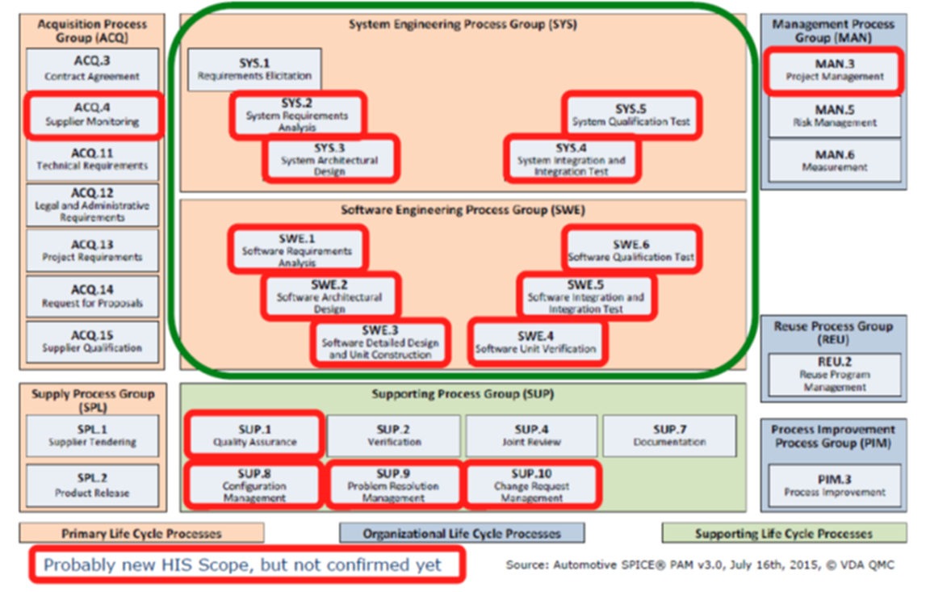
Automotive SPICE Overview
Process Reference Model
Processes are grouped by process category and at a second level into process groups according to the type of activity they address.
There are 3 process categories under which the process groups are categorized
1. Primary life cycle processes
Acquisition Process Group (ACQ)
Supply Process Group (SPL)
System Engineering Process Group (SYS)
Software Engineering Process group (SWE)
2. Organizational life cycle processes
Management Process Group (MAN)
Reuse Process Group (REU)
Process Improvement Process Group (PIM)
3. Supporting life cycle processes
Supporting Process Group (SUP)

Slide 4
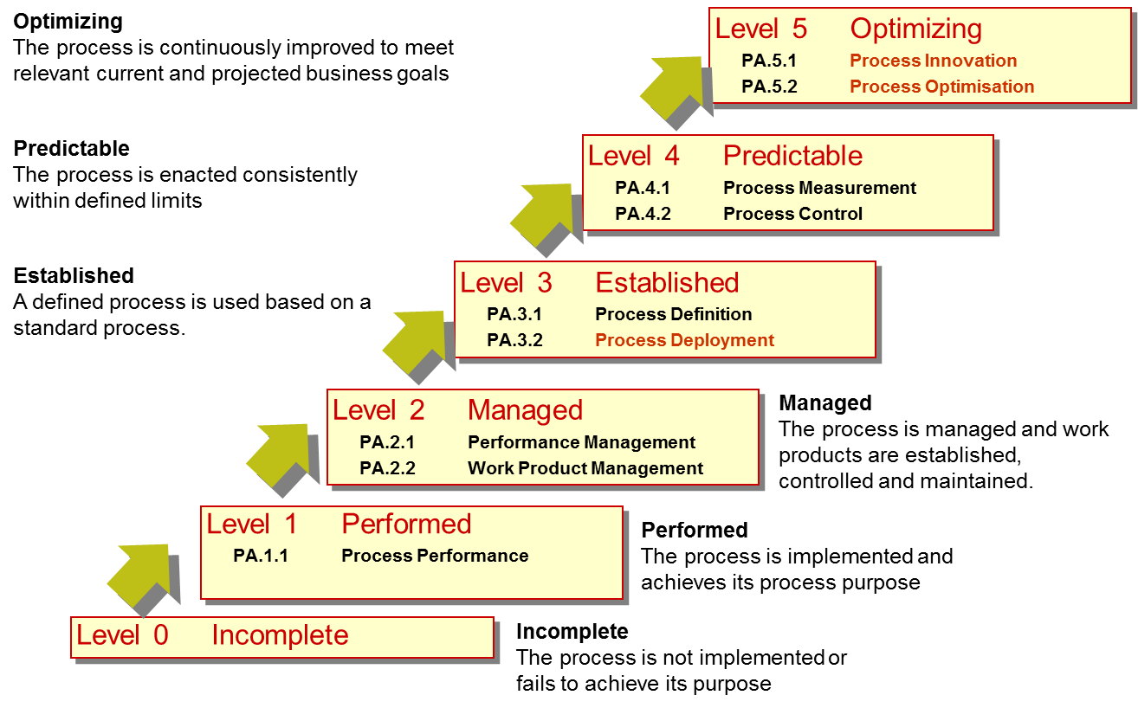
Automotive SPICE Overview
Process Assessment Model
Automotive SPICE 3.1 uses the measurement framework defined in ISO/IEC 33020:2015
Process Capability Levels & Process Attributes
Process attributes are features of a process that can be evaluated on a scale of achievement, providing a measure of the capability of the process. They are applicable to all processes.
A capability level is a set of process attribute(s) that work together to provide a major enhancement in the capability to perform a process. Each attribute addresses a specific aspect of the capability level.
Indicators to identify the Process outcomes & Process attributes outcomes:
Process performance indicators, which fulfill capability Level 1.
Base Practices (BP) and Work Products (WP) ​
Process capability indicators, which fulfill Capability Levels 2 to 5.
Generic Practices​ (GP) and Generic Resources (GR)

Slide 5
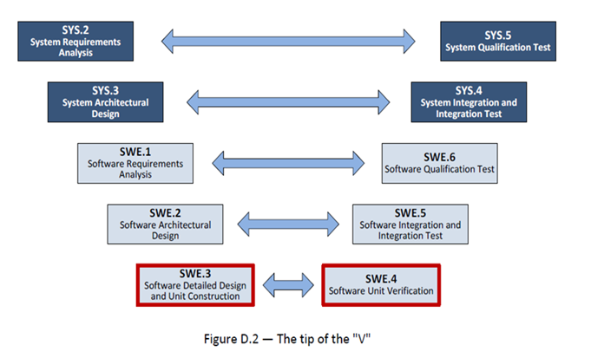
System Defn.

Slide 6
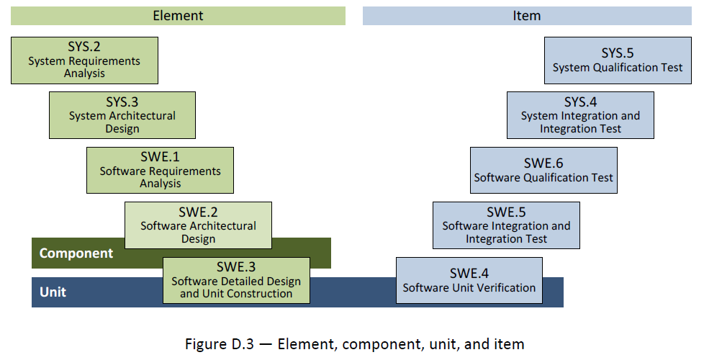
Elements, Component, Unit & Item

Slide 7
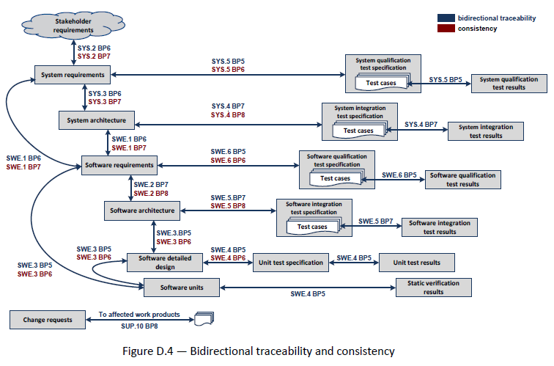
Bi-directional Traceability & Consistency

Slide 8
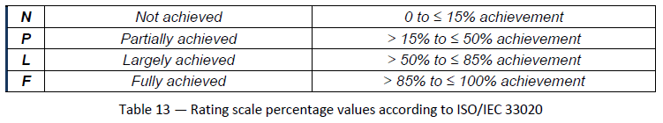
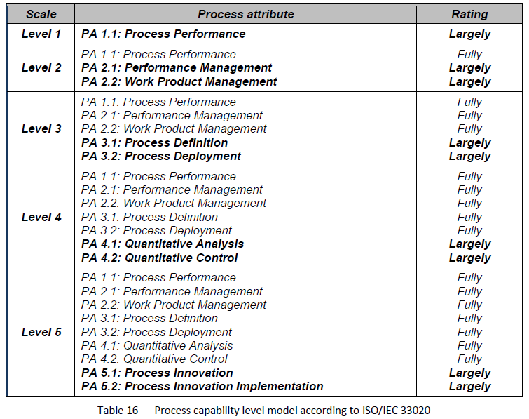
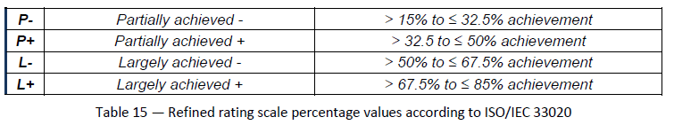
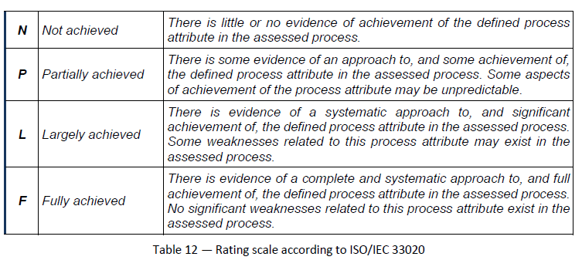
Rating Scale

